Slide 1
Table of Contents
This slide deck consists of slides used in 5 lecture videos in Week 1. Below is a list of shortcut hyperlinks for you to jump into specific sections.
(page 2) Week 1: Introduction to Dynamic Web Content
(page 7) Week 1: Network Sockets and Connections
(page 12) Week 1: HyperText Transfer Protocol
(page 21) Week 1: Building a Simple Web Browser in Python
(page 25) Week 1: Building a Simple HTTP Server in Python

Slide 2

Introduction to Dynamic Web Content
Charles Severance
www.dj4e.com
Notes:
Note from Chuck. If you are using these materials, you can remove my name and URL from this replace it with your own, but please retain the CC-BY logo on the first page as well as retain the entire last page when you remix and republish these slides.
TO Highlight – go to https://tohtml.com/html/ - paste and then do a "Paste RTF"

Slide 3
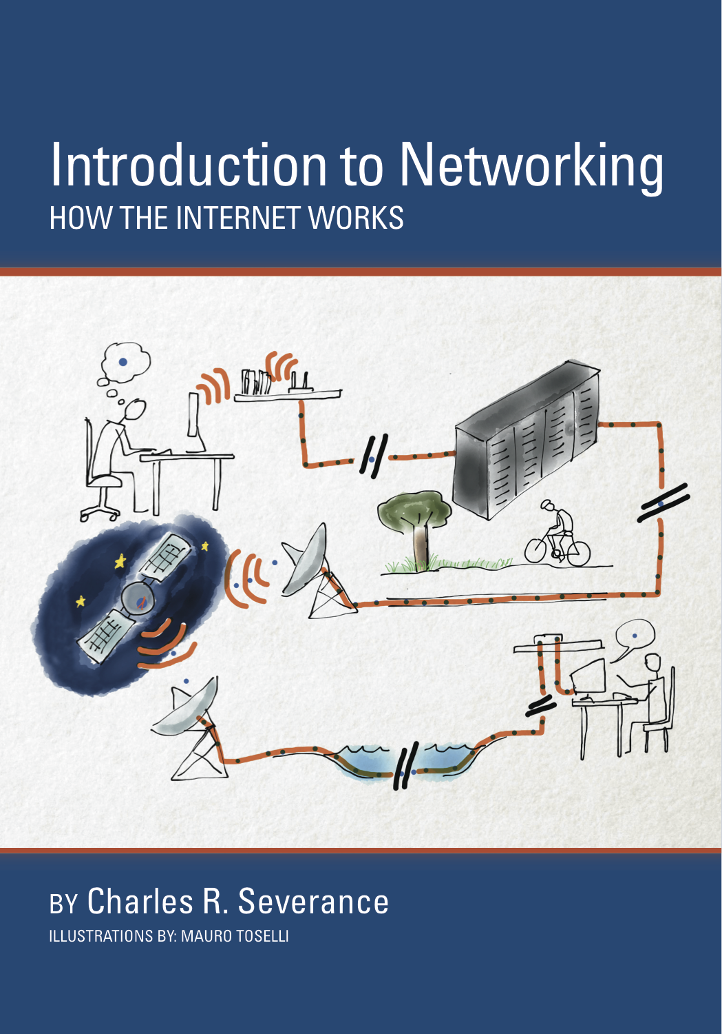
A Free Book on Networking
If you find this topic area interesting and/or need more detail, please visit:
Open Educational Resources: www.net-intro.com
A Coursera course on this topic: www.coursera.org/learn/insidetheinternet

Slide 4
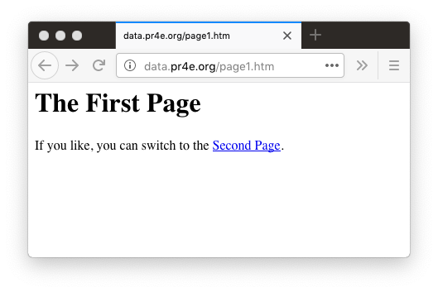

Web Application Technologies
Browser
HTML
CSS
DOM
JavaScript
JQuery
Web Server
Django / Flask
Sqlite3 / MySQL
http://data.pr4e.org/page1.htm

Slide 5
Getting Data from the Server
Each time the user clicks on an anchor tag with an href = value to switch to a new page, the browser makes a connection to the web server and issues a “GET” request - to GET the content of the page at the specified URL.
The server returns the HTML document to the browser, which formats and displays the document to the user.

Slide 6
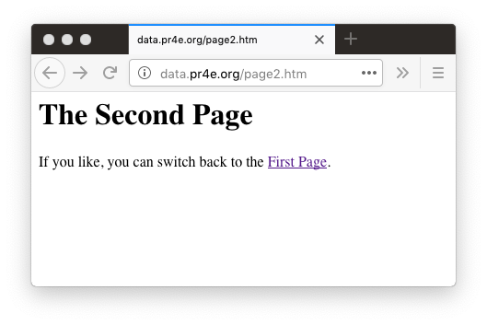
Request and Response Cycle
Web Server
80
Request
Response
GET http://data.pr4e.org/page2.htm
<h1>The Second Page</h1>
<p>If you like, you can switch back to the <a href="page1.htm">First Page</a>.</p>
Browser
App
Click
Parse/
Render

Slide 7
Network Sockets
Phone calls for pairs of applications

Slide 8
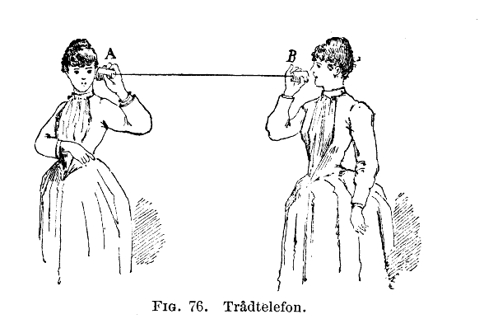
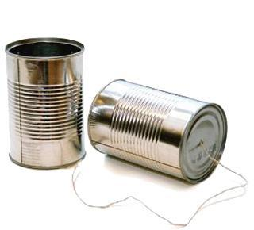
Network Sockets
Image source: http://en.wikipedia.org/wiki/Tin_can_telephone
http://www.flickr.com/photos/kitcowan/2103850699/

Slide 9

TCP Connections / Sockets
“In computer networking, an Internet socket or network socket is an endpoint of a bidirectional inter-process communication flow across an Internet Protocol-based computer network, such as the Internet.”
Application
Process
Application
Process
Internet
http://en.wikipedia.org/wiki/Internet_socket
Notes:
One looking at the Google website, and the other at the Yahoo website.
The connection to Google would be:
Your PC – IP1+port 60200 ——– Google IP2 +port 80 (standard port)
The combination IP1+60200 = the socket on the client computer and IP2 + port 80 = destination socket on the Google server.
The connection to Yahoo would be:
your PC – IP1+port 60401 ——–Yahoo IP3 +port 80 (standard port)
The combination IP1+60401 = the socket on the client computer and IP3 + port 80 = destination socket on the Yahoo server.
Notes: IP1 is the IP address of your PC. Client port numbers are dynamically assigned and can be reused once the session is closed.
TCP/Socket is responsible for data delivery once IP address has been found
TPC is all technology that makes the connection, and enables PC talks to PC/Server.
IP Address + Port number = TCP/Socket

Slide 10
TCP Port Numbers
A port is an application-specific or process-specific software communications endpoint
It allows multiple networked applications to coexist on the same server
There is a list of well-known TCP port numbers
http://en.wikipedia.org/wiki/TCP_and_UDP_port

Slide 11
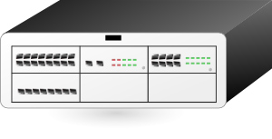

TCP Port Numbers
www.dj4e.com
74.208.28.177
Incoming E-Mail
25
Login
23
blah blah blah blah
Web Server
80
Web Server
443
Personal Mail Box
109
Personal Mail Box
110
Clipart: http://www.clker.com/search/networksym/1

Slide 12
HyperText Transfer Protocol
Wandering through linked documents on the Internet

Slide 13
Uniform Resource Locator
http://data.pr4e.org/page1.htm
protocol
host
document

Slide 14
HTTP - HyperText Transfer Protocol
The dominant Application Layer Protocol on the Internet
Invented for the Web - to retrieve HTML, Images, Documents, etc.
Extended to handle data in addition to documents - RSS, Web Services, etc.
Basic Concept: Make a connection - Request a document - Retrieve the document - Close the connection
Internet and sockets were created in the 1970's, HTTP was invented in 1990 and is an application protocol that runs atop sockets

Slide 15
Internet Standards
INTERNET PROTOCOL DARPA INTERNET PROGRAM PROTOCOL SPECIFICATION September 1981
The standards for all of the Internet protocols (inner workings) are developed by an organization
Internet Engineering Task Force (IETF)
www.ietf.org
Standards are called “RFCs” - “Request for Comments”
The internet protocol treats each internet datagram as an independent entity unrelated to any other internet datagram. There are no
connections or logical circuits (virtual or otherwise).
The internet protocol uses four key mechanisms in providing its
service: Type of Service, Time to Live, Options, and Header Checksum.
Source: http://tools.ietf.org/html/rfc791

Slide 16
Internet Standards
http://www.w3.org/Protocols/rfc2616/rfc2616.txt
Network Working Group R. Fielding
Request for Comments: 2616 UC Irvine
Obsoletes: 2068 J. Gettys
Category: Standards Track Compaq/W3C
J. Mogul
Compaq
H. Frystyk
W3C/MIT
L. Masinter
Xerox
P. Leach
Microsoft
T. Berners-Lee
W3C/MIT
June 1999
Hypertext Transfer Protocol -- HTTP/1.1
Status of this Memo
This document specifies an Internet standards track protocol for the
Internet community, and requests discussion and suggestions for
improvements. Please refer to the current edition of the "Internet
Official Protocol Standards" (STD 1) for the standardization state
and status of this protocol. Distribution of this memo is unlimited.
Copyright Notice
Copyright (C) The Internet Society (1999). All Rights Reserved.
Abstract
The Hypertext Transfer Protocol (HTTP) is an application-level
protocol for distributed, collaborative, hypermedia information

Slide 17
Internet Standards
5 Request
A request message from a client to a server includes, within the
first line of that message, the method to be applied to the resource,
the identifier of the resource, and the protocol version in use.
Request = Request-Line ; Section 5.1
*(( general-header ; Section 4.5
| request-header ; Section 5.3
| entity-header ) CRLF) ; Section 7.1
CRLF
[ message-body ] ; Section 4.3
5.1 Request-Line
The Request-Line begins with a method token, followed by the
Request-URI and the protocol version, and ending with CRLF. The
elements are separated by SP characters. No CR or LF is allowed
except in the final CRLF sequence.
Request-Line = Method SP Request-URI SP HTTP-Version CRLF

Slide 18
Making an HTTP Request
Connect to the server like data.pr4e.org
- a “handshake”
Request a document
GET http://data.pr4e.org/page1.htm HTTP/1.0
GET http://www.mlive.com/ann-arbor/ HTTP/1.0
GET http://www.facebook.com HTTP/1.0

Slide 19
Making an HTTP Request
Note – Telnet is not installed by default on most systems
$ telnet data.pr4e.org 80
Trying 74.208.28.177...
Connected to data.pr4e.org character is '^]'.
GET http://data.pr4e.org/page1.htm HTTP/1.0
HTTP/1.1 200 OK
Date: Thu, 04 Jan 2018 14:45:10 GMT
Server: Apache/2.4.7 (Ubuntu)
Last-Modified: Mon, 15 May 2017 11:11:47 GMT
Content-Type: text/html
<h1>The First Page</h1>
<p>If you like, you can switch to
the <a href="http://www.dr-chuck.com/page2.htm">Second Page</a>.</p>
Connection closed by foreign host.
Web Server
Browser
Notes:
brew install telnet

Slide 20

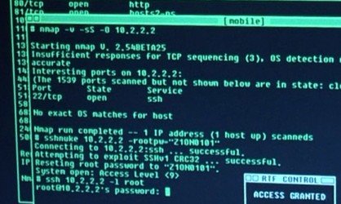

Accurate Hacking in the Movies
Matrix Reloaded
Bourne Ultimatum
Die Hard 4
...
http://nmap.org/movies.html

Slide 21
Simple "Browser" in Python

Slide 22
The World's Simplest Browser
import socket
mysock = socket.socket(socket.AF_INET, socket.SOCK_STREAM)
mysock.connect(('data.pr4e.org', 80))
cmd = 'GET http://data.pr4e.org/page1.htm HTTP/1.0\r\n\r\n'.encode()
mysock.send(cmd)
while True:
data = mysock.recv(512)
if len(data) < 1:
break
print(data.decode(),end='')
mysock.close()
https://www.dj4e.com/code/http/socket1.py

Slide 23
The World’s Simplest Browser
$ python3 socket1.py
HTTP/1.1 200 OK
Date: Sat, 19 Jan 2019 04:23:25 GMT
Server: Apache/2.4.18 (Ubuntu)
Last-Modified: Mon, 15 May 2017 11:11:47 GMT
ETag: "80-54f8e1f004857"
Accept-Ranges: bytes
Content-Length: 128
Cache-Control: max-age=0, no-cache, no-store, must-revalidate
Pragma: no-cache
Expires: Wed, 11 Jan 1984 05:00:00 GMT
Connection: close
Content-Type: text/html
<h1>The First Page</h1>
<p>
If you like, you can switch to the
<a href="http://data.pr4e.org/page2.htm">
Second Page</a>.
</p>
import socket
mysock = socket.socket(socket.AF_INET, socket.SOCK_STREAM)
mysock.connect(('data.pr4e.org', 80))
cmd = 'GET http://data.pr4e.org/page1.htm HTTP/1.0\r\n\r\n'.encode()
mysock.send(cmd)
while True:
data = mysock.recv(512)
if len(data) < 1:
break
print(data.decode(),end='')
mysock.close()

Slide 24
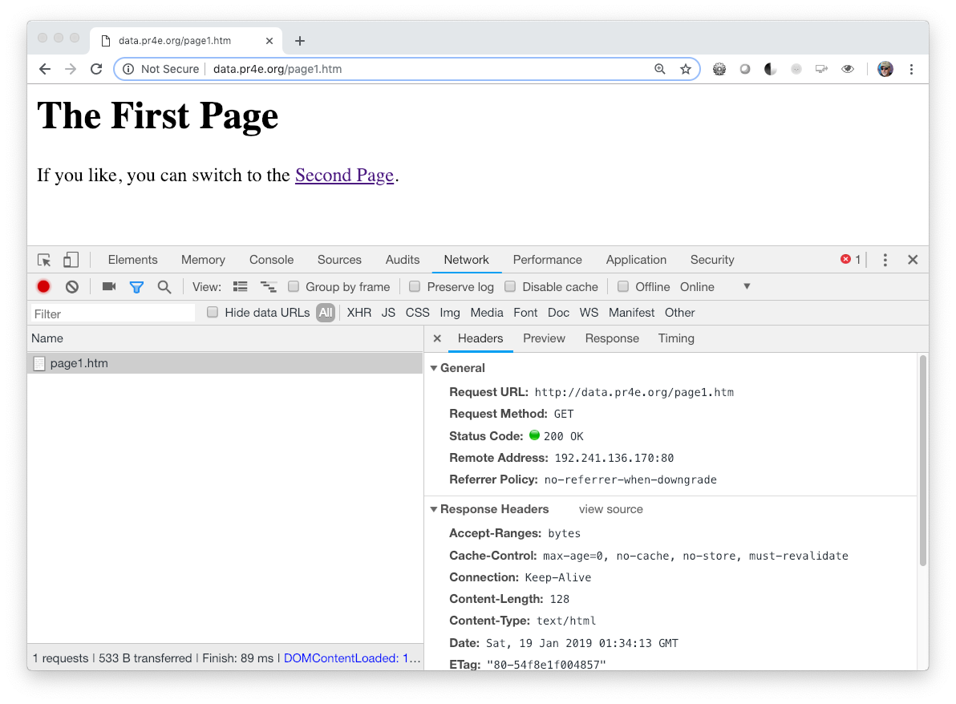
Viewing Headers – Browser Developer Mode
Chrome: View > Developer
FireFox: Tools -> Web Developer -> Toggle
Safari: Preferences > Advanced > Show Develop Menu

Slide 25
In the server
… the mighty server

Slide 26
Request and Response Cycle
Web Server
80
Request
Response
GET http://data.pr4e.org/page2.htm
<h1>The Second Page</h1>
<p>If you like, you can switch back to the <a href="page1.htm">First Page</a>.</p>
Browser
App
Click
Parse/
Render

Slide 27
Request and Response Cycle
Web Server
?????
80
Request
Response
Browser
App
<h1>The Second Page</h1><p>If you like, you can switch back to the <a href="page1.htm">First Page</a>.</p>
GET http://data.pr4e.org/page2.htm

Slide 28
The World's Simplest Web Server
from socket import *
def createServer():
serversocket = socket(AF_INET, SOCK_STREAM)
try :
serversocket.bind(('localhost',9000))
serversocket.listen(5)
while(1):
(clientsocket, address) = serversocket.accept()
rd = clientsocket.recv(5000).decode()
pieces = rd.split("\n")
if ( len(pieces) > 0 ) : print(pieces[0])
data = "HTTP/1.1 200 OK\r\n"
data += "Content-Type: text/html; charset=utf-8\r\n"
data += "\r\n"
data += "<html><body>Hello World</body></html>\r\n\r\n"
clientsocket.sendall(data.encode())
clientsocket.shutdown(SHUT_WR)
except KeyboardInterrupt :
print("\nShutting down...\n");
except Exception as exc :
print("Error:\n");
print(exc)
serversocket.close()
print('Access http://localhost:9000')
createServer()
https://www.dj4e.com/code/http/server.py

Slide 29
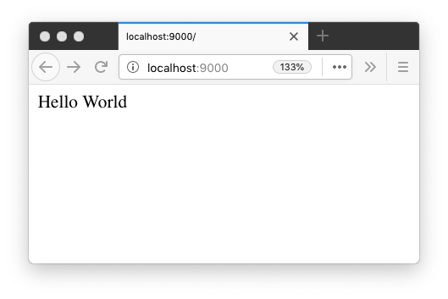
Browser / Server Communication
$ pwd
dj4e/code/http
$ python3 server.py
Access http://localhost:9000
GET / HTTP/1.1
GET /favicon.ico HTTP/1.1
https://www.dj4e.com/code/http/server.py

Slide 30
A Very Simple Web Client
import socket
mysock = socket.socket(socket.AF_INET, socket.SOCK_STREAM)
mysock.connect(('127.0.0.1', 9000))
cmd = 'GET http://127.0.0.1/romeo.txt HTTP/1.0\r\n\r\n'.encode()
mysock.send(cmd)
while True:
data = mysock.recv(512)
if len(data) < 1:
break
print(data.decode(),end='')
mysock.close()
https://www.dj4e.com/code/http/client1.py

Slide 31
Client / Server Communication
$ pwd
dj4e/code/http
$ python3 server.py
Access http://localhost:9000
GET http://127.0.0.1/romeo.txt HTTP/1.0
$ python3 client1.py
HTTP/1.1 200 OK
Content-Type: text/html; charset=utf-8
<html><body>Hello World</body></html>
$

Slide 32
An Even Simpler Web Client
import urllib.request
fhand = urllib.request.urlopen('http://127.0.0.1:9000/romeo.txt')
for line in fhand:
print(line.decode().strip())
$ python3 server.py
Access http://localhost:9000
GET http://127.0.0.1/romeo.txt HTTP/1.0
$ python3 client2.py
<html><body>Hello World</body></html>
$
https://www.dj4e.com/code/http/client2.py

Slide 33
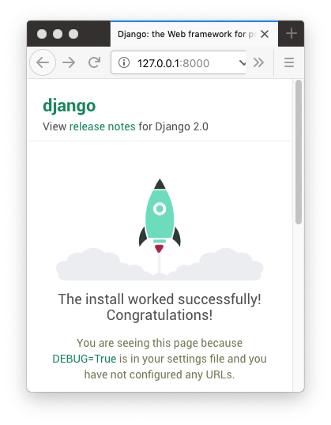
Browser / Django Communication
0587357624:mytestsite csev$ python3 manage.py runserver
Performing system checks...
System check identified no issues (0 silenced).
September 03, 2019 - 13:28:13
Django version 2.1.7, using settings 'mytestsite.settings'
Starting development server at http://127.0.0.1:8000/
Quit the server with CONTROL-C.
[03/Sep/2019 13:28:25] "GET / HTTP/1.1" 200 16348
[03/Sep/2019 13:28:25] "GET /static/admin/css/fonts.css HTTP/1.1" 200 423
Not Found: /favicon.ico
[03/Sep/2019 13:28:25] "GET /favicon.ico HTTP/1.1" 404 1976
[03/Sep/2019 13:28:25] "GET /static/admin/fonts/Roboto-Regular-webfont.woff HTTP/1.1" 200 80304
[03/Sep/2019 13:28:25] "GET /static/admin/fonts/Roboto-Bold-webfont.woff HTTP/1.1" 200 82564
[03/Sep/2019 13:28:25] "GET /static/admin/fonts/Roboto-Light-webfont.woff HTTP/1.1" 200 81348

Slide 34
Acknowledgements / Contributions
These slides are Copyright 2019- Charles R. Severance (www.dr-chuck.com) as part of www.dj4e.com and made available under a Creative Commons Attribution 4.0 License. Please maintain this last slide in all copies of the document to comply with the attribution requirements of the license. If you make a change, feel free to add your name and organization to the list of contributors on this page as you republish the materials.
Initial Development: Charles Severance, University of Michigan School of Information
Insert new Contributors and Translators here including names and dates
Continue new Contributors and Translators here

